Slide 1
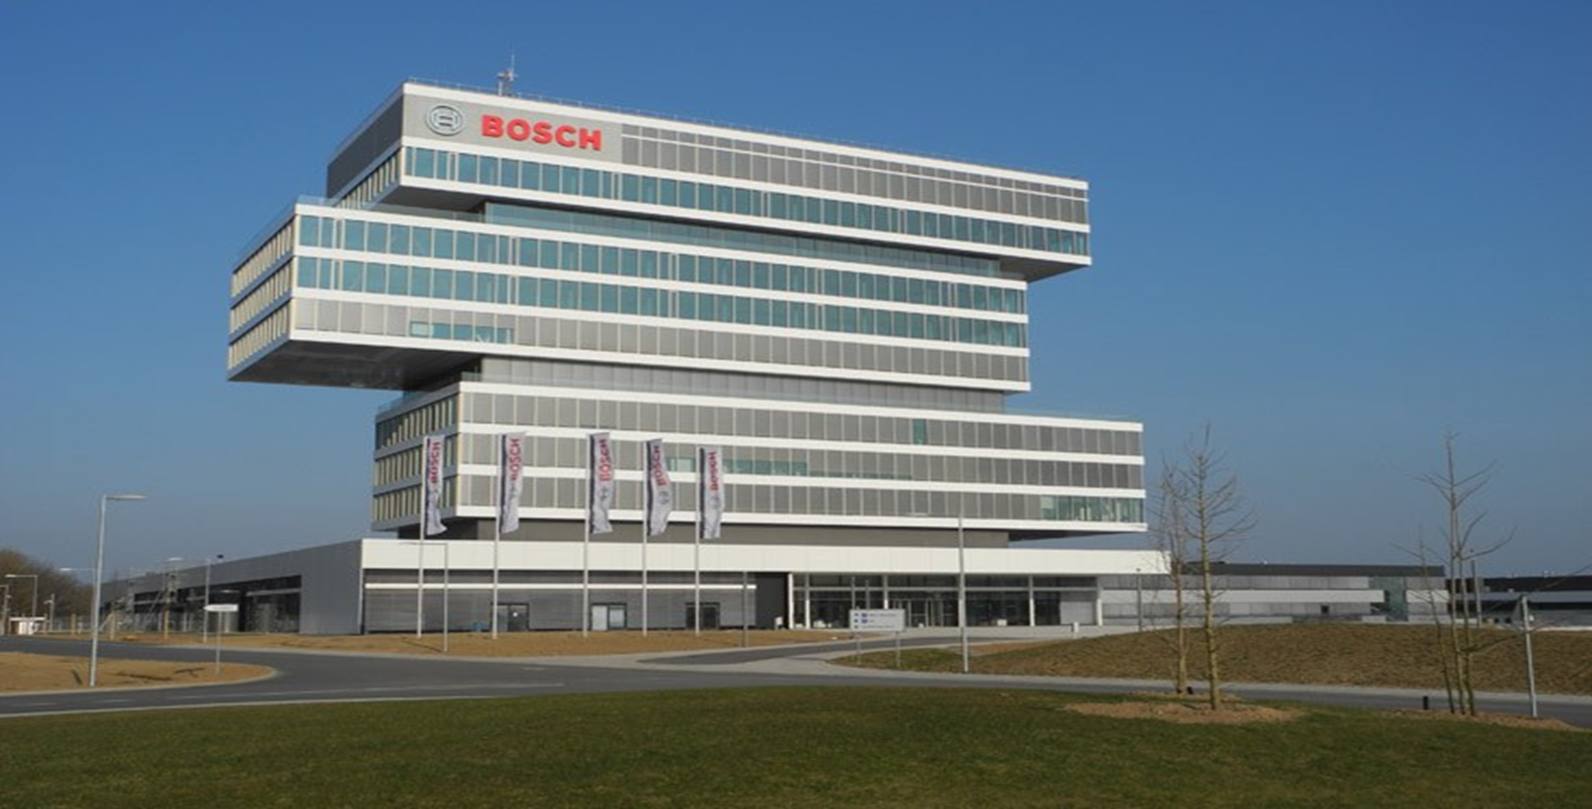




Response-Time Analysis of ROS 2
Processing Chains under Reservation-based Scheduling
Daniel Casini, Tobias Blass, Ingo Lütkebohle, Björn Brandenburg

Slide 2

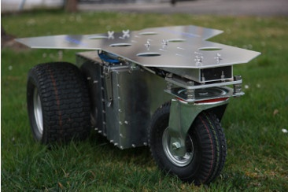
This Paper in a Nutshell
Robots are complex cyber-physical systems, subject to real-time constraints
https://robots.ros.org/robonaut2/
ROS, the most popular robotics framework is not based on real-time system models and no response-time analysis exists
https://robots.ros.org/innok-heros/
This work:
Understand the surprising and undocumented timing behavior of ROS
Develop a response-time analysis that is aware of ROS’s quirks

Slide 3

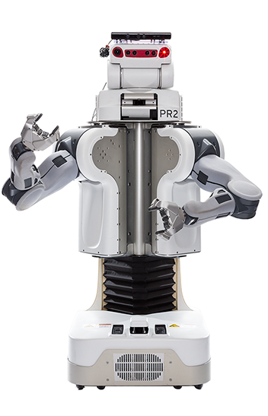
The Robot Operating System (2007)
Popular robotics framework in academia and industry
  > 10 000 users
  > 1000 packages
  > 500 attendees at ROSCon
12 years of development exposed many limitations in the original design
Willow Garage PR2,
the original ROS robot
http://rasc.usc.edu/pr2.html

Slide 4

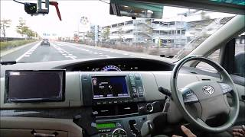
From ROS to ROS 2
Complete refactoring of the ROS framework
Recently released first long-term support version
Aims to support real-time control
https://www.youtube.com/watch?v=npQMzH3j_d8
“We want to support real-time control directly in ROS, including inter-process and inter-machine communication”
From “Why ROS 2?” at design.ros2.org
What does this mean in practice?

Slide 5
Our Needs for Real-Time Control
Support for automated timing validation
  Does this robot react in time?
Support for model-based design-space exploration
  Would this robot react in time if I used this hardware?
  Would this robot react in time if I implemented it that way?
We need a response-time analysis

Slide 6

ROS Systems are distributed networks of callbacks
The Quest for a ROS 2 Response-Time Analysis
Callback
triggers
Callback
triggers
triggers
Callback
timer
triggers
Callback

Slide 7
Callbacks are assigned to executor threads
The Quest for a ROS 2 Response-Time Analysis
Callback
triggers
Callback
triggers
ROS-Level
Scheduling
triggers
Callback
timer
triggers
Callback
Linux-Level
Scheduling
Thread 1
Thread 2

Slide 8
The Quest for a ROS 2 Response-Time Analysis
Callback 2
triggers
Callback 3
triggers
ROS-Level
Scheduling
triggers
Callback 1
timer
triggers
Callback 4
Is callback 2 or callback 4 executed first?
The ROS documentation does not specify the execution order of callbacks

Slide 9
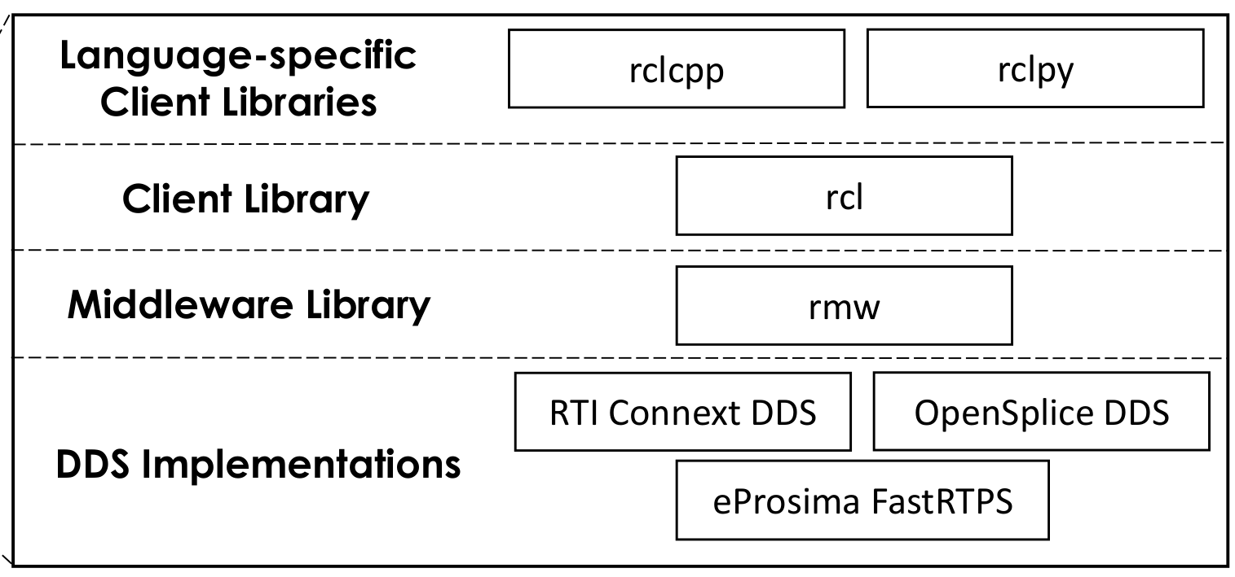
Looking at the source code
The Quest for a ROS 2 Response-Time Analysis
The four layers of the ROS implementation
Question: Which layer determines the callback execution order?
Answer: All of them

Slide 10
Looking at the source code
The Quest for a ROS 2 Response-Time Analysis
The four layers of the ROS implementation
Callback execution order is ROS-specific
and combines properties from
Fixed-priority scheduling
FIFO scheduling
TDMA scheduling

Slide 11
Why not use a framework that prioritizes real-time?
 | ROS | real-time robotics frameworks
Community size | Huge | Small
Effort to integrate third-party software | Low | High
Simulation support | Out-of-the-box, with ready-made models for many parts | None
Hardware Support | Lots of robotics hardware comes with ROS drivers | low-level Linux drivers
Predictability | Difficult | Easy
Guess which one people use?

Slide 12
Make ROS 2 more predictable by
This Work
Understanding and documenting the
ROS 2 timing behavior
Developing an end-to-end response-time analysis for ROS 2

Slide 13
Make ROS 2 more predictable by
This Work
Understanding and documenting the
ROS 2 timing behavior
Developing an end-to-end response-time analysis for ROS 2

Slide 14
ROS Systems consist of callbacks, grouped into nodes
ROS Systems
Node
Node
Node

Slide 15
Nodes communicate using topics (a pub/sub mechanism) …
ROS Systems
Node
Node
Topic /scan
Topic /position
Node

Slide 16
… and services (remote procedure calls)
ROS Systems
Node
Node
Topic /scan
Topic /position
Service /get_map
Node

Slide 17
Nodes are assigned to executor threads
ROS Systems
OS Process
Node
Node
Executor Thread
Executor Thread
Topic /scan
Topic /position
Service /get_map
OS Process
Node
Executor Thread

Slide 18
The operating system’s view
ROS Systems
Linux Scheduler
OS Process
OS Process
Node
Node
Executor
Thread
Executor
Thread
Node
Executor
Thread
IPC Layer
Topics
Services
IPC Layer
Timers
Timers

Slide 19
Who determines the execution order?
Understanding ROS’s Timing Behavior
Linux Scheduler
Controls executor scheduling
OS Process
OS Process
Node
Node
Executor
Thread
Executor
Thread
Controls callback order
Node
Executor
Thread
IPC Layer
Topics
Services
IPC Layer
Timers
Timers

Slide 20
Who determines the execution order?
Understanding ROS’s Timing Behavior
well understood
(SCHED_DEADLINE)
Linux Scheduler
OS Process
OS Process
Node
Node
Executor
Thread
ROS-specific, undocumented
Executor
Thread
Node
Executor
Thread
IPC Layer
Topics
Services
IPC Layer
Timers
Timers

Slide 21
The Executor’s Algorithm
Processing Window
Execute highest-priority callback
Remove callback from readySet
Polling Point
readySet := ready sources
in IPC Layer
timer ready?
yes
no
topic in readySet?
yes
no
service in readySet?
yes
no
service reply in readySet?
no
yes

Slide 22
Peculiarities of the Executor
Execute highest-priority callback
Remove callback from readySet
readySet := ready sources
in IPC Layer
timer ready?
yes
except for timers
no
Events only noticed at the next polling point
topic in readySet?
yes
no
service in readySet?
yes
no
service reply in readySet?
no
yes

Slide 23
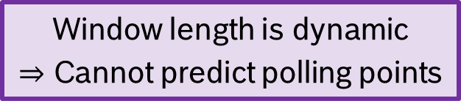
Peculiarities of the Executor
Execute highest-priority callback
Remove callback from readySet
readySet := ready sources
in IPC Layer
timer ready?
yes
no
topic in readySet?
yes
no
Window length is dynamic
$⇒$ Cannot predict polling points
service in readySet?
yes
no
service reply in readySet?
no
yes

Slide 24
Peculiarities of the Executor
Execute highest-priority callback
Remove callback from readySet
Only one event per processing window per source
readySet := ready sources
in IPC Layer
timer ready?
yes
except for timers
no
topic in readySet?
yes
no
service in readySet?
yes
no
service reply in readySet?
no
yes

Slide 25

The Executor: Summary
The ROS 2 Executor differs significantly from the usual schedulers
Existing models and analyses cannot be applied directly:
  Existing models don’t capture the necessary information
  Existing analyses don’t consider the quirks of the ROS 2 Executor
The artifact contains an experiment that validates our model of the executor’s behavior

Slide 26
Make ROS 2 more predictable by
This Work
Understanding and documenting the
ROS 2 timing behavior
Developing an end-to-end response-time analysis for ROS 2

Slide 27
Compositional Performance Analysis (CPA) Henia et. al., 2005
Response-Time Analysis
Per-Task Analysis
Computes per-task response times given event arrival curves
Fixed-point search
Arrival-Curve Propagation
Computes event arrival curves given per-task response times
CPU
CPU
task
task
task
task

Slide 28
The CPA approach fits ROS well
Response-Time Analysis
CPU
CPU
task
task
task
task
Executor reservation
Executor reservation
callback
callback
callback
callback

Slide 29
Extending CPA for ROS
Response-Time Analysis
Per-Callback Analysis
Fixed-point search
Arrival-Curve Propagation
Needs to account for ROS’s quirks
Inherited from CPA unchanged
Executor
Executor
callback
callback
callback
callback

Slide 30


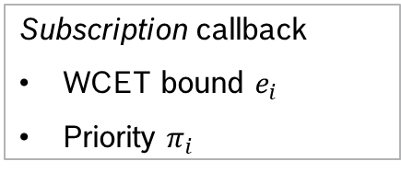
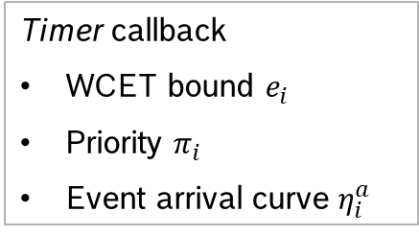
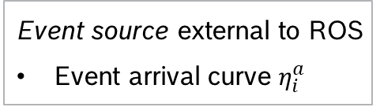
A real-time model for ROS 2
Response-Time Analysis
Subscription callback
WCET bound $e_{i}$
Priority $π_{i}$
Timer callback
WCET bound $e_{i}$
Priority $π_{i}$
Event arrival curve $η_{i}^{a}$
Processing chains of interest
Communication Delay${ δ}_{i,j}$
Event source external to ROS
Event arrival curve $η_{i}^{a}$

Slide 31
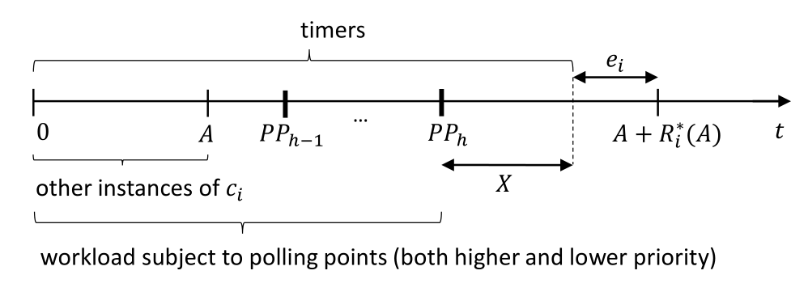
A per-callback response-time analysis for ROS
Response-Time Analysis
Dedicated analyses for timers and polling-point-based callbacks
Busy-window analysis without critical instant assumptions
Optimization for intra-executor chains

Slide 32
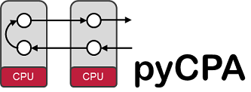
Case Study:
The move_base Navigation Stack

Slide 33
Processing Steps
Timing-critical processing chain
odometry
pose
Local
map
Local
planner
wheels
position
Global
map
Global
planner
laser
scanner
Can we implement this safely in ROS 2?

Slide 34
Our Needs for Real-Time Control
Support for automated timing validation
  Does this robot react in time?
Support for model-based design space exploration
  Would this robot respond in time if I used this hardware?
  Would this robot respond in time if I implemented it that way?

Slide 35
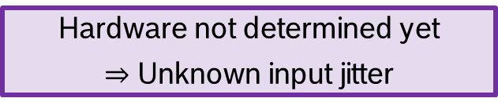
Hardware Uncertainty
odometry
pose
Local
map
Local
planner
wheels
position
Global
map
Global
planner
laser
scanner
Hardware not determined yet
$⇒$Unknown input jitter

Slide 36
Two Implementation Choices
odometry
Time-Driven
store
pose
Local
map
Local
planner
position
laser
scanner
Global
map
Global
planner
How well do both variants cope with increasing input jitter?
odometry
store
pose
Local
map
Local
planner
Event-Driven
position
laser
scanner
Global
map
Global
planner

Slide 37
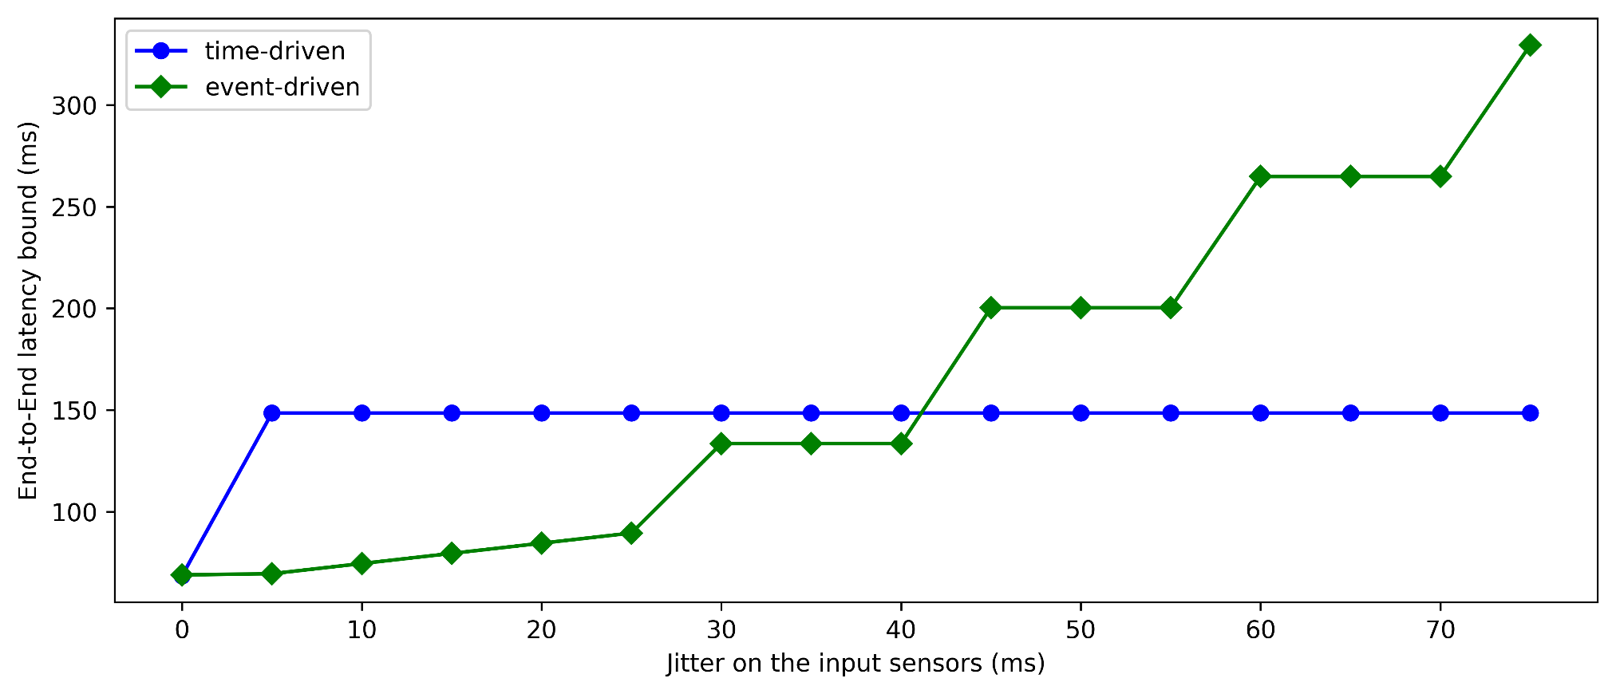
Exploring Jitter Sensitivity

Slide 38
Exploring Jitter Sensitivity
fixed sampling latency
Not affected by jitter

Slide 39
Exploring Jitter Sensitivity
Increasing self-interference
no sampling latency

Slide 40
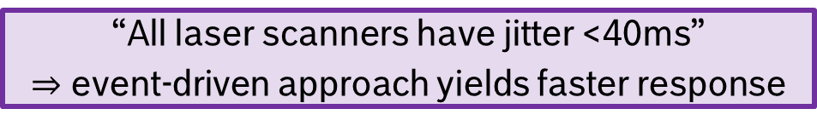
Exploring Jitter Sensitivity
“All laser scanners have jitter <40ms”
$⇒$ event-driven approach yields faster response

Slide 41
Exploring Jitter Sensitivity
Response-time analysis allows nonobvious tradeoffs
early in the design phase

Slide 42
Future Work
Extract the timing model automatically
static analysis or runtime system introspection
Develop a real-time executor
  Discussions with ROS developers underway (Join us!)

Slide 43
Summary
Contributions
  A comprehensive description of the ROS 2 execution model
  A response-time analysis for ROS 2 applications
This work enables ROS users to
  Explore the design space cheaply and early
  Provide safety guarantees for their applications
This work provides real-time researchers with
  A task model that reflects the leading robotics framework
Source code available at https://github.com/boschresearch/ros2_response_time_analysis

